Slide 1


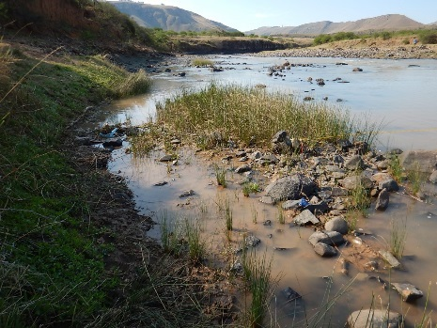
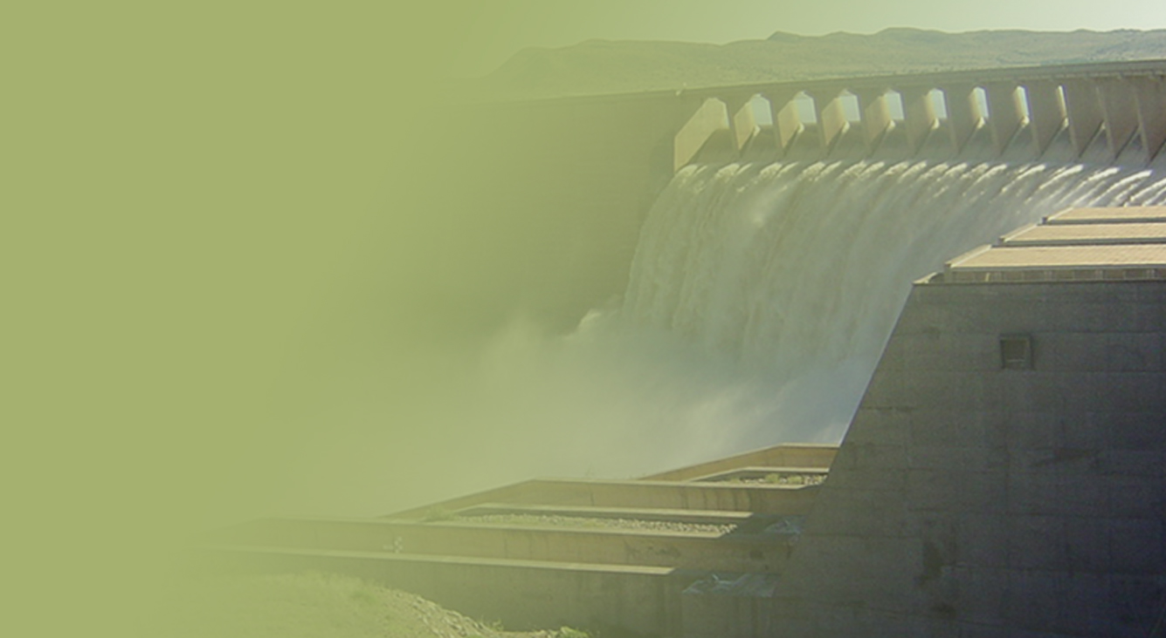
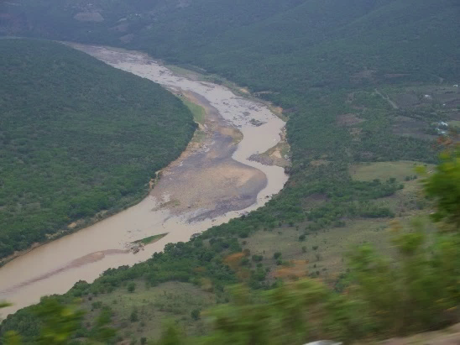
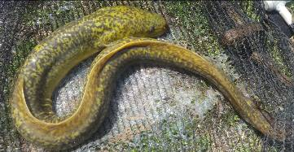
WP 11004: PSC MEETING 1,
5 DECEMBER 2016
PRESENTATION TITLE
Presented by:
Name Surname
Directorate
Date
DETERMINATION OF WATER RESOURCE CLASSES AND RESOURCE QUALITY OBJECTIVES FOR THE WATER RESOURCES IN THE MZIMVUBU CATCHMENT:
PRIORITISATION AND RIVER RESOURCE UNITS
Delana Louw, Rivers for Africa

Slide 2
RESOURCE UNITS & PRIORITISATION: WHERE DOES IT FIT?
Delineate and prioritise RUs and select study sites
Select river reaches and prioritise
2. Describe status quo and delineate into IUAs
Select catchments or reaches that are homogenous
4. Identify and evaluate Scenarios within IWRM
How will the current state and ecological objectives be influenced by future changes in operation?
3. Quantify BHNR & EWR
How much water do you need for basic human needs and to maintain a certain ecological status?
5. Determine Classes & catchment configurations for Scenarios
For each scenario, determine the associated Class
6. Determine RQOs
Supply the narrative and numerical limits and provide implementation information
Legal Notice and Gazetting process

Slide 3
RIVER SQ PRIORITY

Slide 4
WHERE ARE THE HIGH PRIORITY SQs? (1)
What are Sub Quaternary River reaches?
It is short sections of river from the inflow of one tributary to the inflow of a next tributary – the baseline is the 1:500 000 rivers network scale.
186 SQs in the Mzimvubu
SQ
SQ
SQ
SQ
SQ
SQ
SQ

Slide 5
WHERE ARE THE HIGH PRIORITY SQs? (2)
Why do we need to evaluate priority SQs?
EWR sites (detail study sites) should be situated in the rivers which include high priority SQs
The position of the high priority SQs within the river informs the selection of EWR sites
RQOs at detailed level must be set for rivers with high priority SQs
A detailed process for selecting RUs which may comprise more than one SQ are undertaken for rivers with high priority SQs.

Slide 6
WHERE ARE THE HIGH PRIORITY SQs? (3)
What does one consider and how does one determine the priorities?
High priority SQs are river reaches with a combination of high important ratings and within a good state.
If a SQ is rated as high, it means one has to be careful making decisions regarding changes to the current operation of the reach, and
future developments may require detailed investigations for informed decision-making.
The following is considered: Ecologically important river SQs; River SQs in good condition; Socio-Cultural Importance, Water Resource Use Importance.

Slide 7
WHERE ARE THE HIGH PRIORITY SQs? (4)
Process to determine priority ratings
PES
EI & ES
SCI
Use calculations to derive Integrated Environmental Importance
Integrated Environmental Importance
Water Resource Use Importance
Use calculations to identify high priority areas (hot spots)
River reaches with allocated priority rating

Slide 8
WHERE ARE THE HIGH PRIORITY SQs? (5)
What is Ecological Classification?
EcoClassification consists of three processes:
- Present Ecological State (PES)
- Ecological Importance and Sensitivity (EIS)
- Recommended Ecological Category (REC)
The PES describes the resource according to ecological status or health compared to natural conditions.
EIS is described in terms of Low, Moderate, High and Very High

Slide 9
WHERE ARE THE HIGH PRIORITY SQs? (6)
How do we determine the PES and EIS for 186 SQs?
PES and EIS: DWS database exists with this information. Reviewed for this project.
PES and EIS are part of EcClassification.
PES and EIS are determined using rule-based models that score various criteria, e.g. for PES: rule-based models rate metrics from 0 (no change from natural) to 5 (severe change from natural).
Metrics are: Bed modification, Flow modification, Inundation, Riparian bank modification, water quality modification
This is undertaken for a reach of river (SQ).
Tools mostly used are GOOGLE EARTH and any readily available information.

Slide 10
WHERE ARE THE HIGH PRIORITY SQs? 7)
How do we determine the Socio-Cultural Importance for 186 SQs?
Rule based model.
Evaluates the following: Ritual Use, Aesthetic Value, Resource Dependence, Recreational Use, Historical/Cultural Value.
Scores 0 – 5.
Some of the metrics are weighted.
Each SQ evaluated and output is a Very Low, Low, Moderate, High or Very High rating.

Slide 11
WHERE ARE THE HIGH PRIORITY SQs? (7)
How do we determine the Water Resource Use Importance for 186 SQs?
Rule based model.
Evaluates the following: Current water balance of catchment contributing to flow; Operational purposes; Groundwater Development Impact on Baseflows; Future development and water use; River and dam water quality
Scores 0 – 4.
Metric with highest rating becomes overall rating.
Each SQ evaluated and output is a Low, Moderate, High or Very High rating.

Slide 12
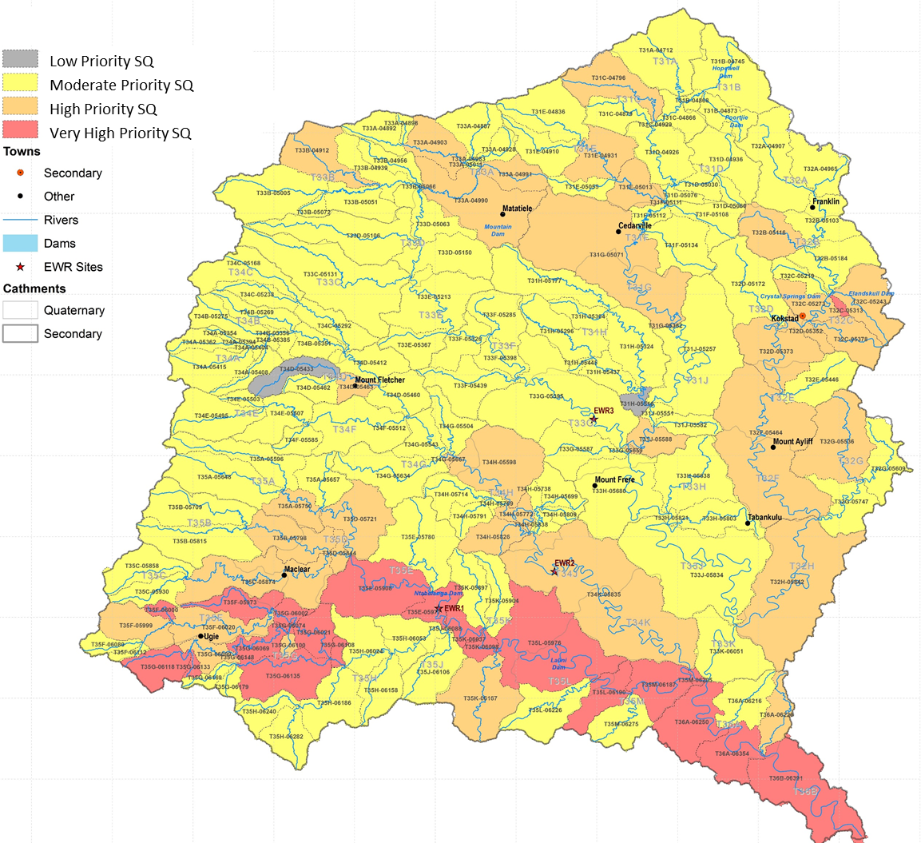
WHERE ARE THE HIGH PRIORITY SQs? (8)
Thina (ecological and SCI importance)
Mzintlava (IEI and WRUI)
Mzimvubu (future development)
Tsitsa, Gatberg, Inxu (Tsitsa – future development)

Slide 13
RIVER RU SELECTION

Slide 14
RIVER RESOURCE UNITS (1)
What are river RUs?
RUs require different EWRs (due to different flow patterns, reaction of habitat and biota to stress, management and operational structures).
RUs are always linear (i.e. a river reach)
The detailed approach applied on rivers with many high priority SQs in is called the determination of Management Resource Units
The other rivers (dominated by low and moderate priority RUs) consist of RUs that combines SQs where the PES and landuse are similar.

Slide 15
RIVER RESOURCE UNITS (2)
How are Management Resource Units (MRUs) determined?
Natural Resource Units based on EcoRegions and Geomorph Zones are first assessed.
Then, superimpose land-use, and
PES, and
Operational Structures
This results in MRUs which must be reaches that are similar in state, land-use and operation and can therefore be managed as an entity.

Slide 16
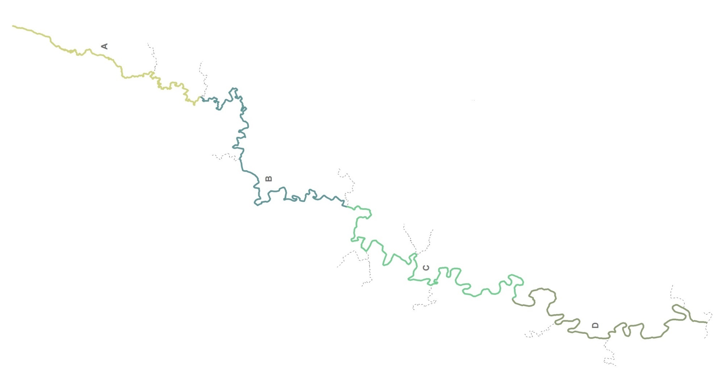
TSITSA MRUs
MRU A: Source to end of T35A-05750:
Land use is similar, operation, PES similar.
Separate MRU selected as EWR of upper source area not similar to area below.
MRU B: To proposed Ntabelanga Dam:
DS border due to proposed dam which will result in very different operation downstream.
MRU similar in all aspects (coincides with NRU B.
MRU C: To proposed Laleni Dam:
Reasoning the same as for MRU B
MRU D: To confluence:
Reach similar and does not warrant further delineation. Coincides largely with NRU Tsitsa D

Slide 17
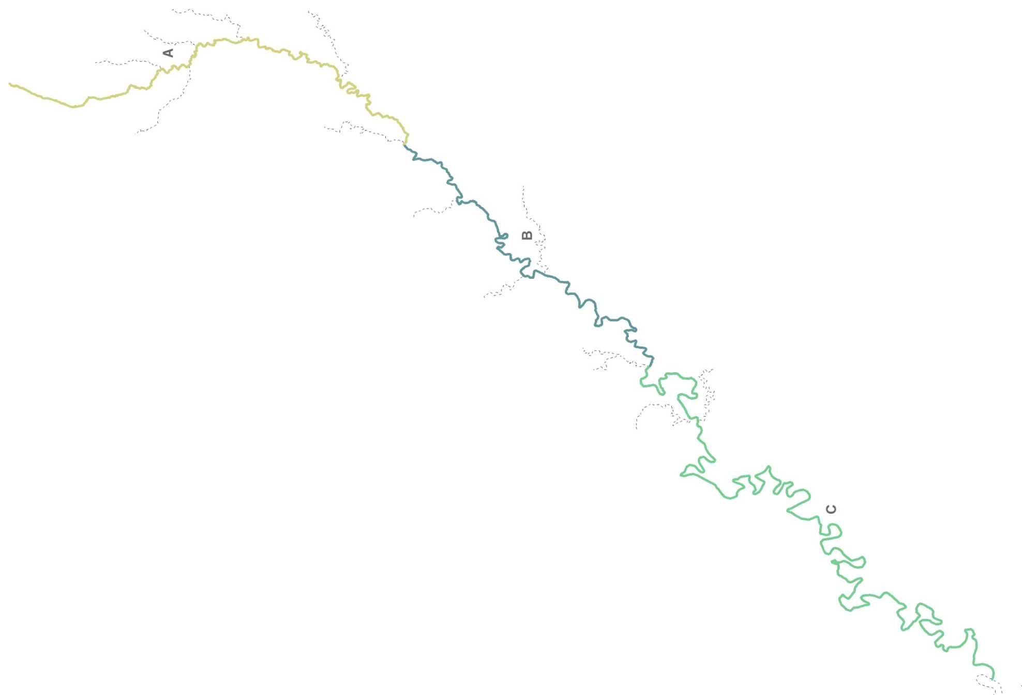
MRU A: Source to end of T34D-05412:
System operation and land use different DS of Mount Fletcher.
THINA MRUs
MRU B: To proposed end of T34H-05595:
Change due to change in PES (more gorge type river, better state).
MRU C: To confluence:
Reach similar and does not warrant further delineation.

Slide 18
WHERE TO FROM HERE - IUAs
SQs are linear and can be RUs or fall within a RU
RUs are also linear and are similar in definition to an Integrated Unit of Analysis (IUA)
RUs are nested within IUAs which are mostly catchments but can also be linear if the main river is very different from the tributaries
Next speaker will explain IUAs further and provide the delineation

Slide 19
ESTUARY RESOURCE UNITS

Slide 20
DELINEATION
RUs for estuaries refer to a single estuary
Estuary delineation must include all areas subjected to tidal action or back flooding when mouth closes, i.e. all estuarine associated vegetation and processes not only the estuary water body but also supporting physical and biological processes and habitats necessary for that estuarine function and health
Downstream boundary: Estuary mouth. Upstream boundary: limits of tidal variation or salinity penetration, whichever penetrates furthest.

Slide 21
Estuary functional zone (EFZ) defines geographical boundaries for estuaries, in the case of the Mzimvubu Estuary:
  Downstream boundary: Estuary mouth (31°7'52” S, 29°32'59” E )
  Upstream boundary: limits of tidal variation or salinity penetration, whichever penetrates furthest (31°29'7.15"S, 29°22'59.66"E)
  Lateral boundary: +5 m contour above Mean Sea Level along each bank

Slide 22
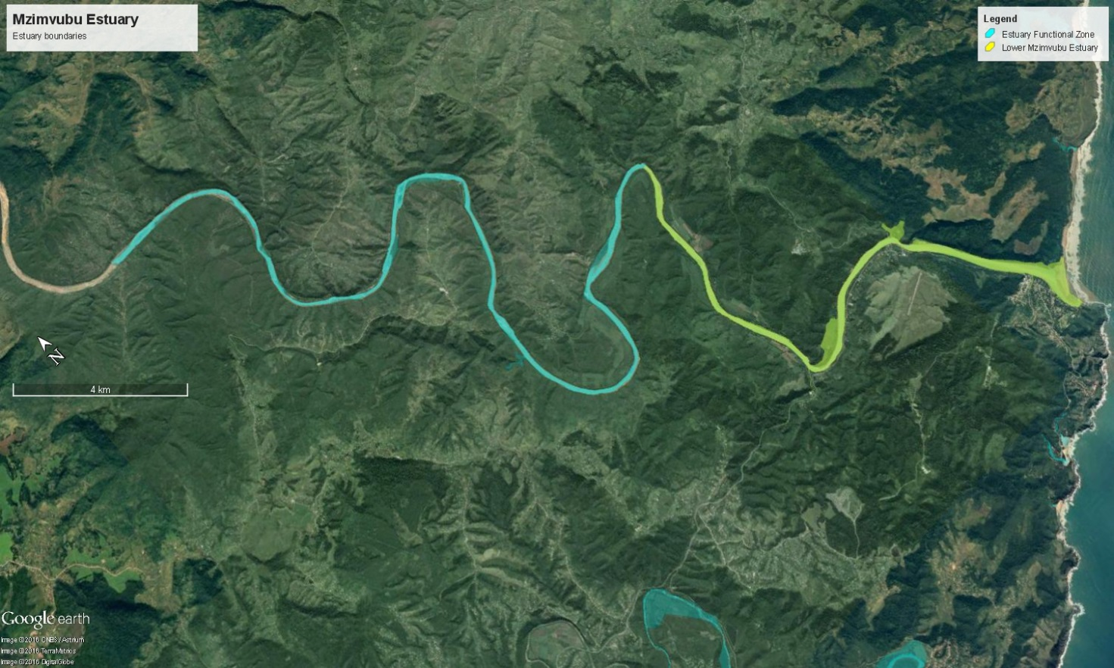
MZIMVUBU ESTUARY FUNCTIONAL ZONE

Slide 23
QUESTIONS FOR CLARIFICATION

